Slide 1

The Role of Metabolic Dysfunction in Heart Failure
2013 Cardiac Physiome Workshop, Bar Harbor, ME October 17, 2013
Scott M. Bugenhagen
MD/PhD student
Department of Physiology
Medical College of Wisconsin

Slide 2
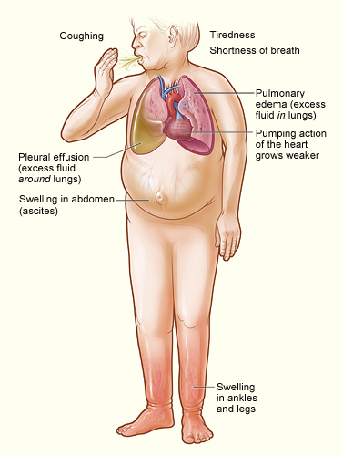

What is heart failure?
“heart failure: inability of the heart to maintain cardiac output sufficient to meet the body's needs” -Dorland’s Medical Dictionary, 2007
Dx involves various algorithms (Framingham, European Society of Cardiology, others) based on criteria from medical history, physical examination, laboratory tests, response to therapy, etc.
image from wikipedia.org

Slide 3
___ __ ___ ____ __ _________ _______ __ _____ _______
What causes heart failure?
Adapted from Beard, Examination of the “Dominant Role of the Kidneys in Long-Term Regulation of Arterial Pressure and in Hypertension”, Physiology Seminar 2013
Notes:
3

Slide 4
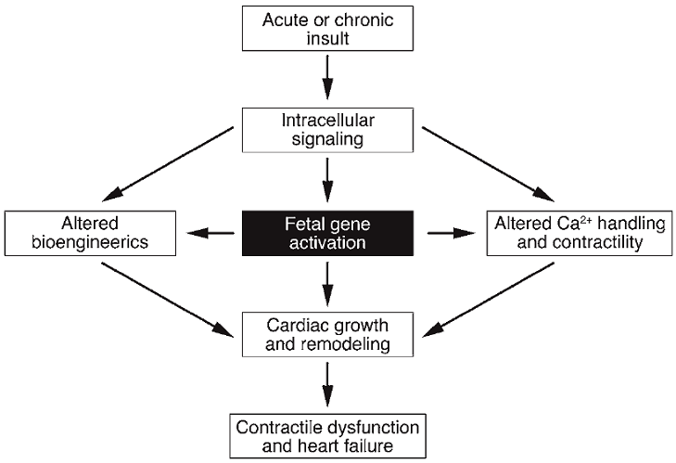
What causes heart failure?
???
Adapted from McKinsey, T.A. and Olson, E.N. (2005) J Clin Invest 115, 538-46.
Notes:
The major focus of my thesis is determining if/how metabolic failure determines the loss of mechanical function in heart failure, and whether any loss of mechanical function in heart failure can be predicted by simulating cardiac energetics and excitation-contraction coupling based on a clinically measured energetic phenotype.
We know that major clinical symptoms of heart failure include impaired pumping, venous congestion, and a rise in LVEDP, and I just showed you data demonstrating that alterations in metabolite pools can lead to an impaired energetic state. Could this mechanical dysfunction be a result of the reduction in the free energy of ATP hydrolysis inhibiting the myosin ATPase of the contractile apparatus, or the ability of the SERCA to load the SR with calcium. Or is it primarily the result of structural remodeling and/or other forms of remodeling that are known to occur in heart failure. We don’t intend to account for this other remodeling in our simulations. Rather than being a hindrence, this will actually allow for more powerful analyses with regard to determing the degree to which energetic failure alone is responsible for mechanical alterations in heart failure.

Slide 5
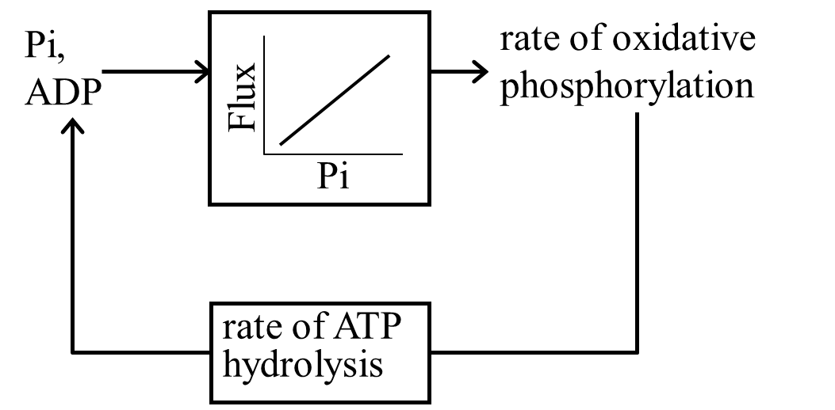
A Primer on Cardiac Energy Metabolism
Physiological control:
In vitro (purified mitochondria) and in vivo data are consistent with the hypothesis that cardiac energy metabolism is primarily regulated through feedback of substrates for oxidative phosphorylation.
In heart failure:
Changes in metabolite pools lead to diminished ATP hydrolysis potential.
Wu et al. (2009) PNAS USA 106:7143-7148.
EDP <
15 mmHg
EDP >
15 mmHg
Notes:
One of the major accepted theories with regard to the control of the rate of ATP synthesis in the mitochondria, and the one supported by much of the work done by the Beard lab in the last 8 years, is that inorganic phosphate plays the role as the key negative feedback regulator in cardiac energy metabolism, disproving the previous held hypotheses that energetic state is maintained in the absence of feedback control, or by calcium stimulation.
B. An important finding by former postdoctoral fellow Fan Wu and Dr. Beard, published in PNAS in 2009, is that a decline in adenine nucleotides causes a reduction in the free energy of ATP hydrolysis in late stages of left ventricular hypertrophy, as demonstrated in this figure.
5

Slide 6
A Primer on Cardiac Energy Metabolism
K⁺
Ca²⁺
Ca²⁺
Na⁺
H⁺
HCO₃⁻
OH⁻
Na⁺
HCO₃⁻
ATP
ATP
Ca²⁺
Na⁺
K⁺
Na⁺
Na⁺
K⁺
Na⁺
Cl⁻
Cl⁻
GLUT
Pyr
Glycolysis
Glc
Ca²⁺
NADH
Mitochondria
FACS
FATP
Subspace
MAS
FACoA
FFA
Sacroplasmic
reticulum
N_{XB}
Na⁺
NAD
Ca²⁺
Ca²⁺
Ca²⁺
ATP
ADP
+
P_{i}
MgATP
Ca²⁺
AM1
P_{XB}
ATP
MgADP
P_{i}
Ca²⁺
AM2
XB_{PreR}
Cytoplasm
Myofilaments
Ca²⁺
Notes:
One of the major accepted theories with regard to the control of the rate of ATP synthesis in the mitochondria, and the one supported by much of the work done by the Beard lab in the last 8 years, is that inorganic phosphate plays the role as the key negative feedback regulator in cardiac energy metabolism, disproving the previous held hypotheses that energetic state is maintained in the absence of feedback control, or by calcium stimulation.
B. An important finding by former postdoctoral fellow Fan Wu and Dr. Beard, published in PNAS in 2009, is that a decline in adenine nucleotides causes a reduction in the free energy of ATP hydrolysis in late stages of left ventricular hypertrophy, as demonstrated in this figure.
6

Slide 7
Can energy failure cause heart failure?
Goal: To develop a mathematical model linking cardiac energy metabolism with cell- and organ-level cardiac mechanics and whole-body cardiovascular dynamics in order to test the hypothesis that energy failure alone provides a sufficient explanation for the mechanical changes observed in heart failure.

Slide 8
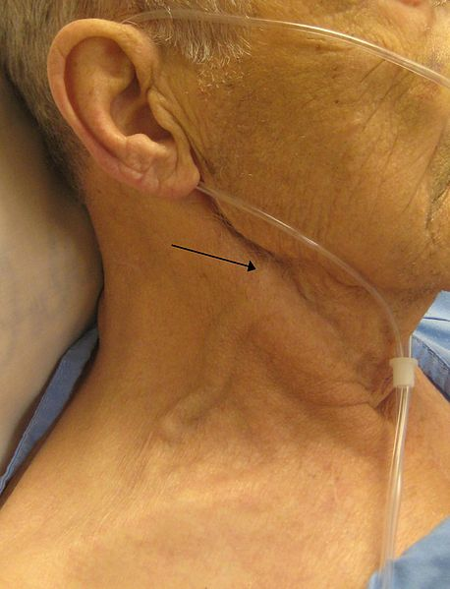
___ __ ___ ____ __ _________ _______ __ _____ _______
The Grand Vision
image from wikipedia.org
Notes:
8

Slide 9
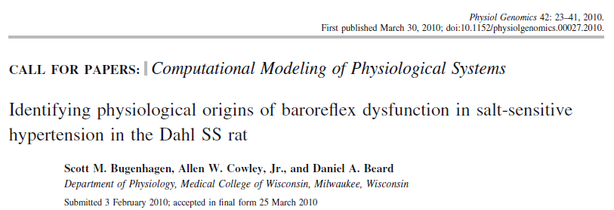
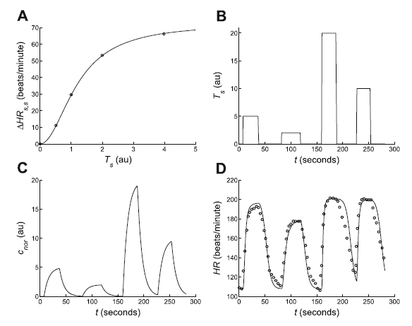
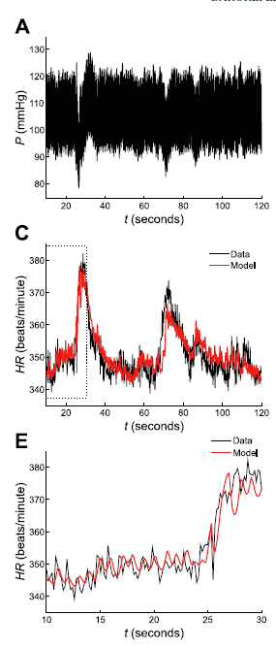
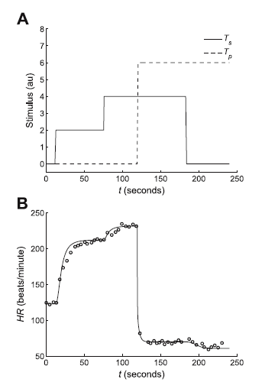
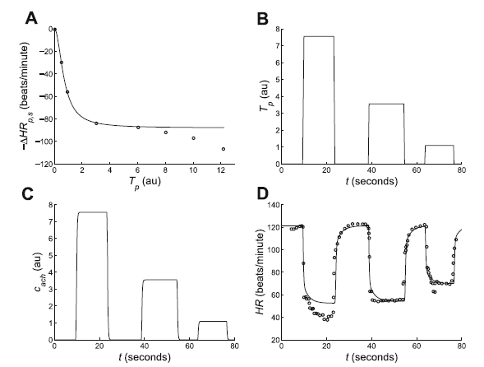
Baroreflex and autonomic control of heart rate

Slide 10
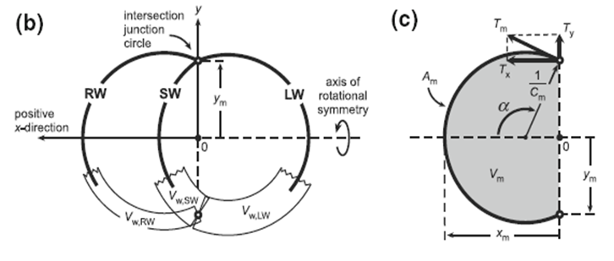
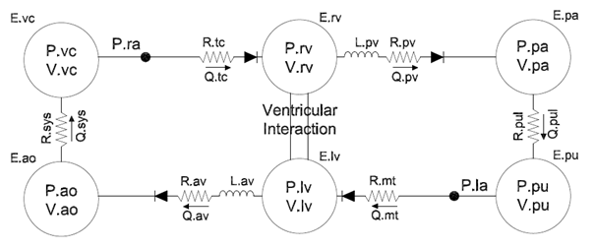
Cardiovascular hemodynamics
from Lumens J, Arts T, et al. Ann Biomed Eng. 2009 Nov;37(11):2234-55
from Smith BW, JG Chase , et al. Medical Engineering & Physics. 2004 Mar;26(2):131-39

Slide 11
Cardiovascular hemodynamics

Slide 12
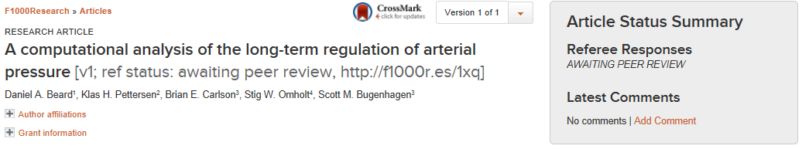
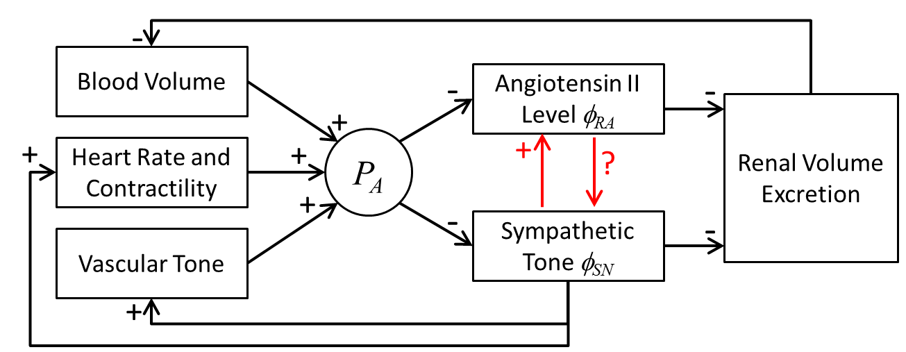
Renal blood-volume control

Slide 13
Renal blood-volume control

Slide 14
___ __ ___ ____ __ _________ _______ __ _____ _______
The Grand Vision
image from wikipedia.org
Notes:
14

Slide 15
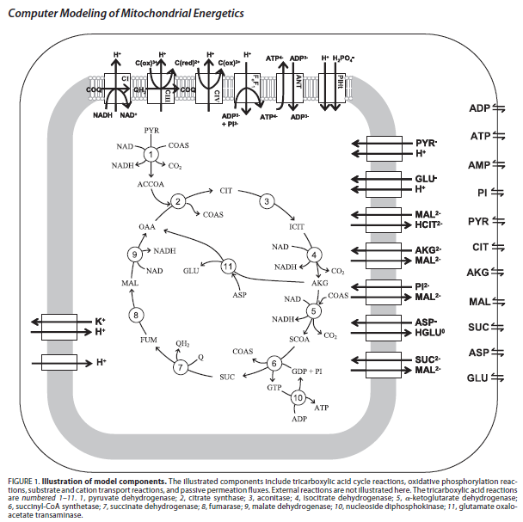
___ __ ___ ____ __ _________ _______ __ _____ _______
Cardiac energy metabolism
From Wu et al. (2007) JBC 282:24525-24537
Notes:
15

Slide 16
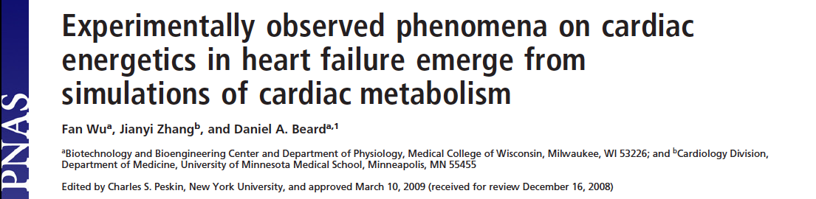
___ __ ___ ____ __ _________ _______ __ _____ _______
Cardiac energy metabolism
12
0.12
12
10
0.10
10
8
0.08
8
6
0.06
6
4
0.04
4
2
0.02
2
0
0
0
2
4
6
8
10
0
2
4
6
8
10
12
0
2
4
6
8
10
12
0
12
Notes:
16

Slide 17
___ __ ___ ____ __ _________ _______ __ _____ _______
Cardiac cell mechanics
Components
Electrophysiology
Calcium handling
Signaling (CaMKII, β-AR, others)
Cross-bridge
Sympathetic nerve
Norepinephrine
K⁺
Ca²⁺
Ca²⁺
Na⁺
H⁺
HCO₃⁻
OH⁻
Na⁺
HCO₃⁻
ATP
ATP
Ca²⁺
Na⁺
K⁺
Na⁺
Na⁺
K⁺
Na⁺
Cl⁻
Cl⁻
GLUT
Pyr
Glycolysis
Glc
Ca²⁺
NADH
Mitochondria
FACS
FATP
Diad space
MAS
FACoA
FFA
Na⁺
Sacroplasmic
reticulum
NAD
N_{XB}
Ca²⁺
Ca²⁺
Ca²⁺
ATP
ADP
+
P_{i}
MgATP
Ca²⁺
AM1
P_{XB}
CaMKII
ATP
MgADP
P_{i}
Ca²⁺
AM2
XB_{PreR}
Cytoplasm
Myofilaments
Ca²⁺
Notes:
17

Slide 18
___ __ ___ ____ __ _________ _______ __ _____ _______
Cardiac cell mechanics
Components
Electrophysiology
Calcium handling
Signaling (CaMKII, β-AR, others)
Cross-bridge
Sympathetic nerve
Norepinephrine
Ca²⁺
Ca²⁺
ATP
Na⁺
Ca²⁺
fast
buffer
slow
buffer
Ca²⁺
Diad space
Sacroplasmic
reticulum
Ca²⁺
Ca²⁺
Ca²⁺
CaMKII
ATP
Myofilaments
Ca²⁺
Ca²⁺
Cytoplasm
Notes:
18

Slide 19
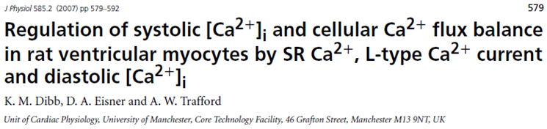
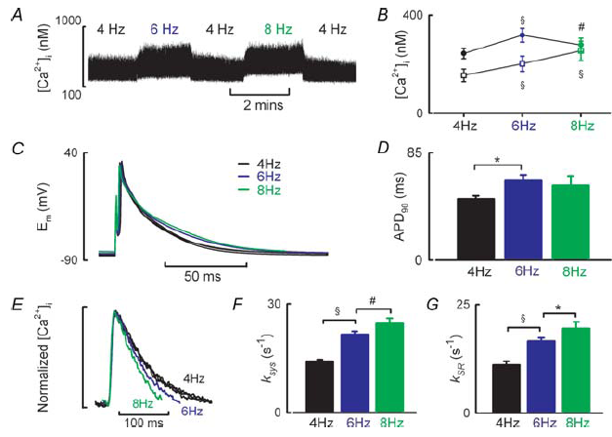
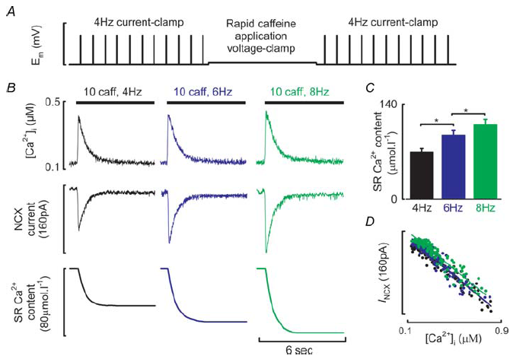
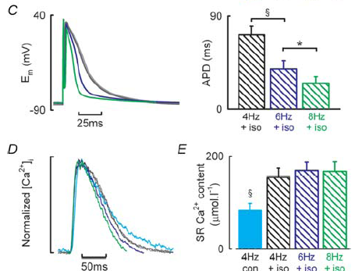
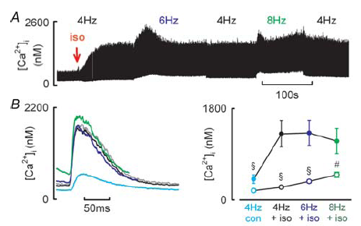
___ __ ___ ____ __ _________ _______ __ _____ _______
Cardiac cell mechanics
Notes:
19

Slide 20
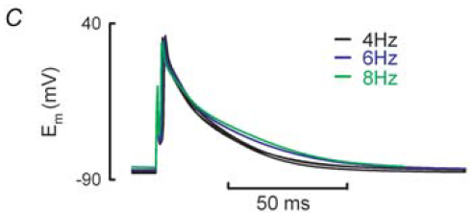
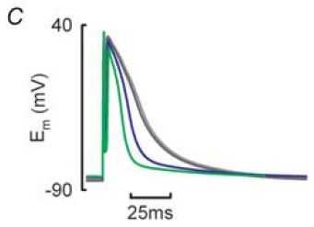
___ __ ___ ____ __ _________ _______ __ _____ _______
Electrophysiology
control
w/ 30nM isoprenaline
Notes:
20

Slide 21
___ __ ___ ____ __ _________ _______ __ _____ _______
Calcium handling
Notes:
21

Slide 22
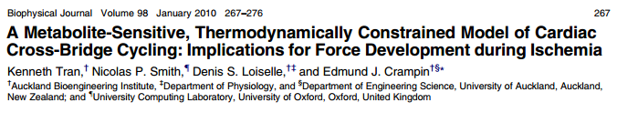
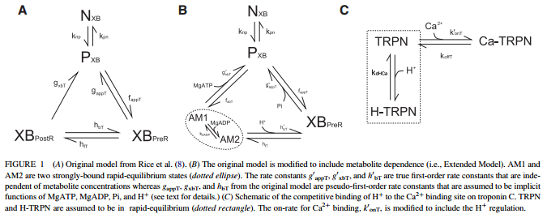
___ __ ___ ____ __ _________ _______ __ _____ _______
Cross-bridge
Notes:
22

Slide 23
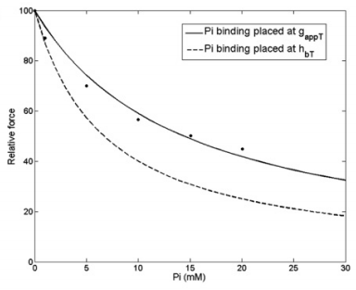
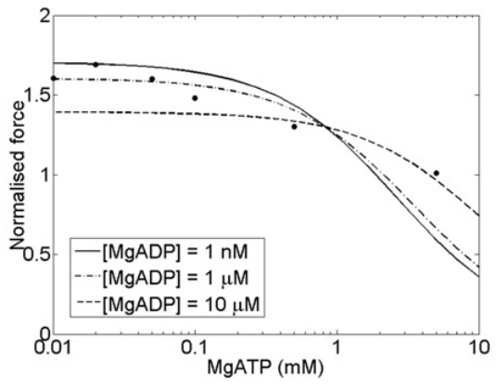
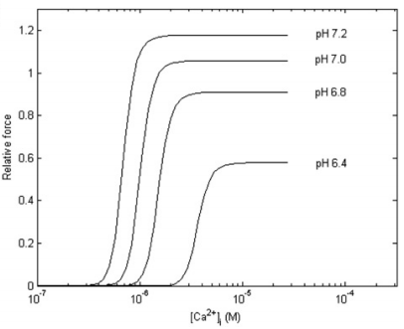
___ __ ___ ____ __ _________ _______ __ _____ _______
Cross-bridge
Notes:
23

Slide 24
___ __ ___ ____ __ _________ _______ __ _____ _______
Integrated HF model version 1.0 – Lumens/Smith/Wu/Tran
Healthy resting conditions:
MVO₂ ≈ 3.5 μmol O₂ min⁻¹ (g tissue)⁻¹
[MgATP] ≈ 8 mM
[MgADP] ≈ 0.08 mM
[Pi] ≈ 0.2 mM
HF resting conditions:
MVO₂ ≈ 3.5 μmol O₂ min⁻¹ (g tissue)⁻¹
[MgATP] ≈ 1.5 mM
[MgADP] ≈ 0.01 mM
[Pi] ≈ 0.8 mM
Notes:
24

Slide 25
___ __ ___ ____ __ _________ _______ __ _____ _______
Integrated HF model version 1.0 – Lumens/Smith/Wu/Tran
Healthy resting conditions:
MVO₂ ≈ 3.5 μmol O₂ min⁻¹ (g tissue)⁻¹
[MgATP] ≈ 8 mM
[MgADP] ≈ 0.08 mM
[Pi] ≈ 0.2 mM
HF resting conditions:
w/ Volume adjusted to 0.61 x control
MVO₂ ≈ 3.5 μmol O₂ min⁻¹ (g tissue)⁻¹
[MgATP] ≈ 1.5 mM
[MgADP] ≈ 0.01 mM
[Pi] ≈ 0.8 mM
Notes:
25

Slide 26
___ __ ___ ____ __ _________ _______ __ _____ _______
Integrated HF model version 1.0 – Lumens/Smith/Wu/Tran
Healthy exercise conditions:
w/ Resistance adjusted to 0.33 x control
MVO₂ ≈ 10.5 μmol O₂ min⁻¹ (g tissue)⁻¹
[MgATP] ≈ 8 mM
[MgADP] ≈ 0.1 mM
[Pi] ≈ 2.5 mM
HF exercise conditions:
w/ Resistance adjusted to 0.25 x control
w/ Volume adjusted to 0.61 x control
MVO₂ ≈ 10.5 μmol O₂ min⁻¹ (g tissue)⁻¹
[MgATP] ≈ 1.5 mM
[MgADP] ≈ 0.04 mM
[Pi] ≈ 10 mM
Notes:
26

Slide 27
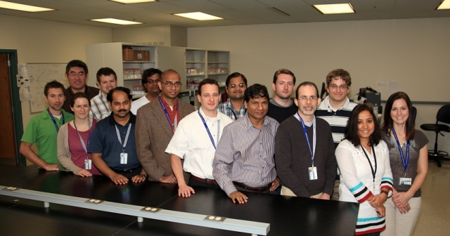
___ __ ___ ____ __ _________ _______ __ _____ _______
Acknowledgements
Dissertation Committee
Daniel Beard (Advisor)
Brian Carlson
Paul Goldspink
Andrew Greene
Michael Widlansky
Jeff Saucerman
Funding
VPR - National Institute of Health Grant No. P50-GM094503
Programs
Department of Physiology Graduate Program
Medical Scientist Training Program
Notes:
27

